Slide 1
Riemann Surfaces
Team members:
Muhammad Farouk
Ammar Ahmed
Fahmy Ahmed
Course: Special Topics in Physics (PEU 461)
Instructor: Dr. Ahmed Abdealim

Slide 2
Outline
Introduction
Analytic Functions
Single-Valued Functions
Multi-Valued Function (with some examples)
The Idea of a Riemann Surface
Intuitive Approach
General Approach
Some Applications

Slide 3
Introduction
The idea of a Riemann Surface is to employ the power of complex analysis on a general 2-D surface that satisfies a set of conditions. In this work, we, first, discuss analytic functions and the properties they fulfill. Then, we discuss the single-valued analytic functions and the emergent problem with multi-valued analytic functions and give some examples on multi-valued functions. After that, we turn the discussion to introduce a more rigorous definition of a Riemann Surface. At last, we study some applications to shed the light on the usefulness of Riemann Surfaces.

Slide 4
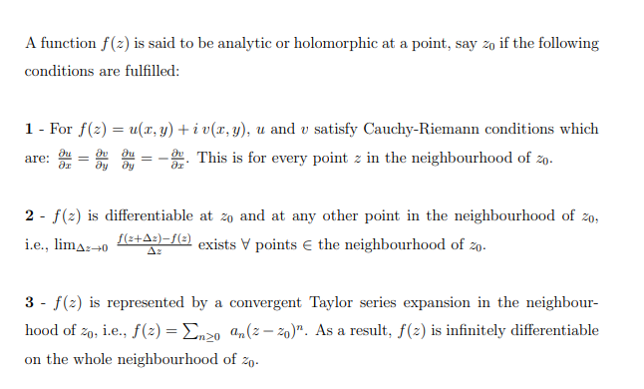
Analytic Functions

Slide 5
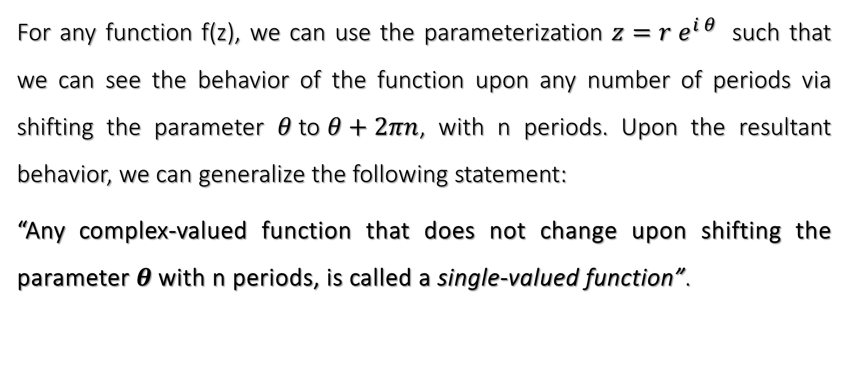
Single-Valued Functions
For any function f(z), we can use the parameterization $z=r e^{i θ}$ such that we can see the behavior of the function upon any number of periods via shifting the parameter $θ$to $θ+2πn$, with n periods. Upon the resultant behavior, we can generalize the following statement:
“Any complex-valued function that does not change upon shifting the parameter $θ$with n periods, is called a single-valued function”.

Slide 6
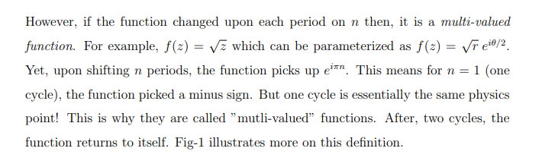
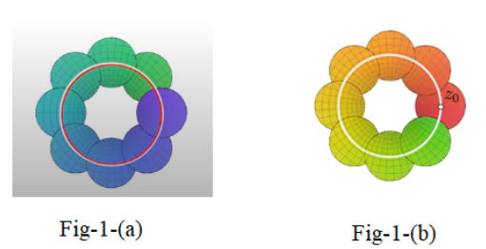
Multi-Valued Function (with some examples)

Slide 7
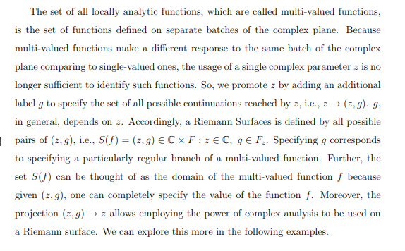
Multi-Valued Function (with some examples)

Slide 8

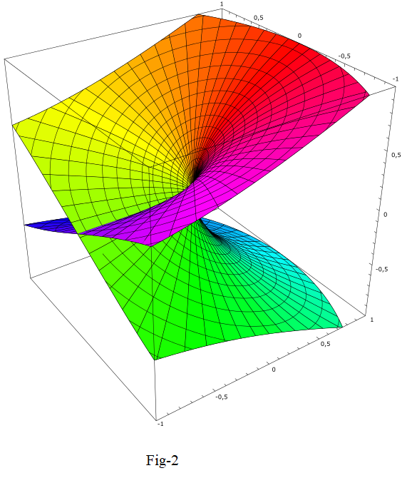

Slide 9

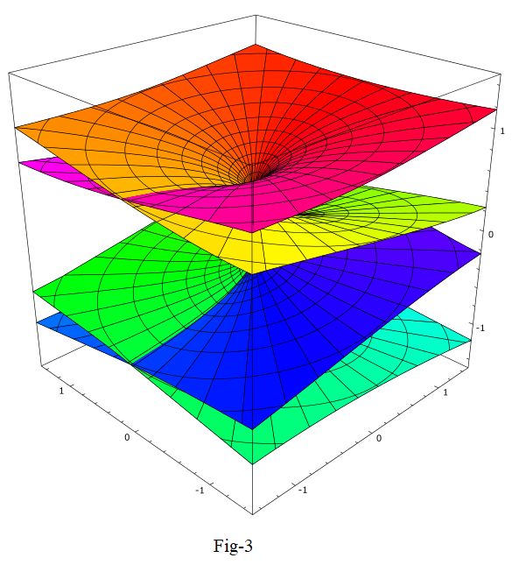

Slide 10

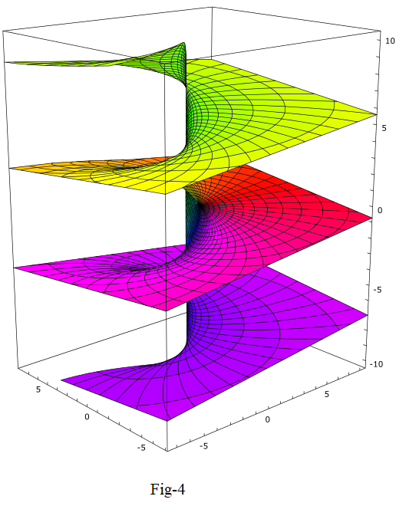

Slide 11
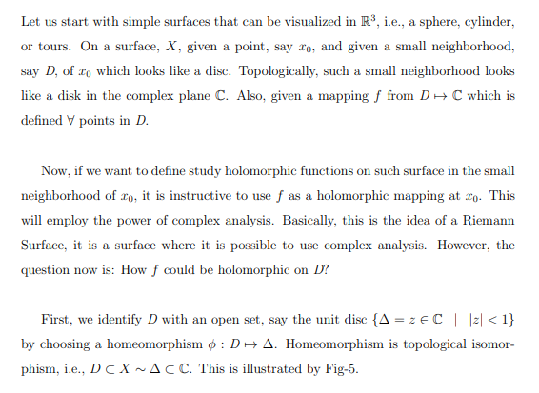
The Idea of a Riemann Surface: Intuitive Approach

Slide 12
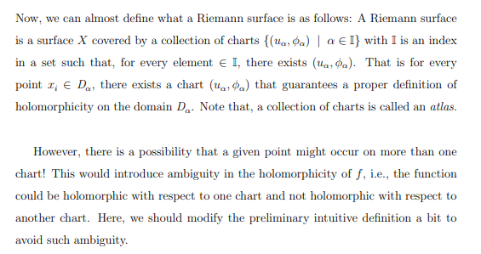
The Idea of a Riemann Surface: Intuitive Approach

Slide 13
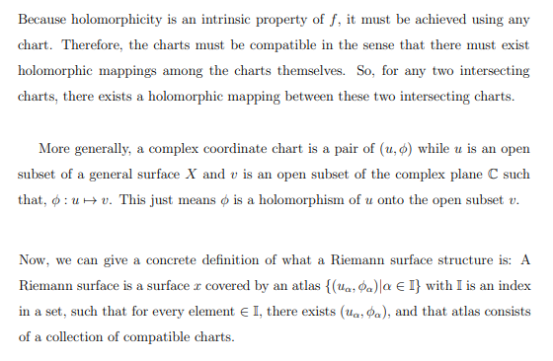
General Approach

Slide 14

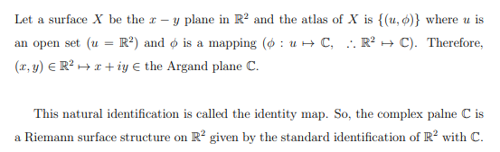
Some Applications

Slide 15

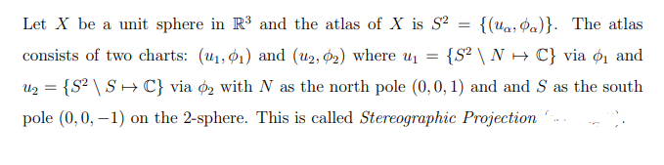
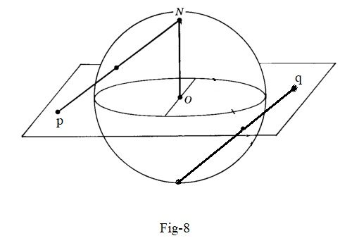
Some Applications

Slide 16
